Slide 1
Fragment Techniques
강영민
동명대학교 게임공학과

Slide 2
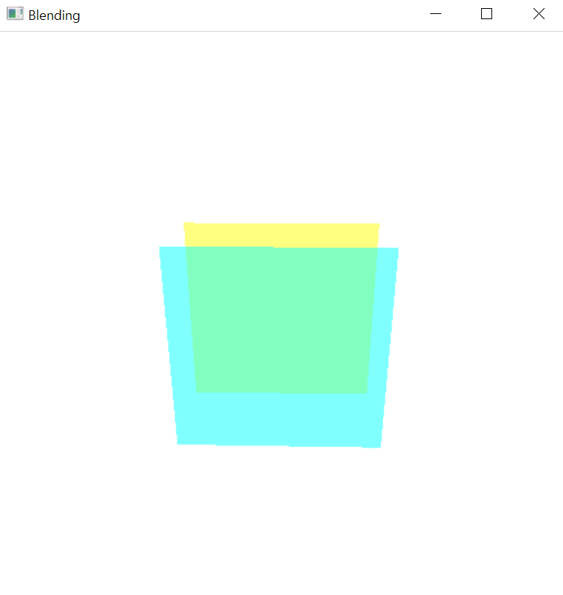
Blending
glutInitDisplayMode
GLUT_RGBA
Blending 활성화
glEnable(GL_BLEND);
glBlendFunc(GL_SRC_ALPHA, GL_ONE_MINUS_SRC_ALPHA);
glColor3f → glColor4f
R, G, B + A (alpha = opacity)

Slide 3
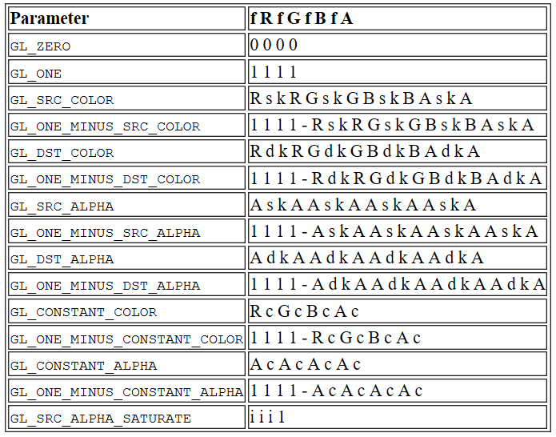
glBlendFunc
glBlendFunc(sourceFactor, destinationFactor)
Possible values

Slide 4
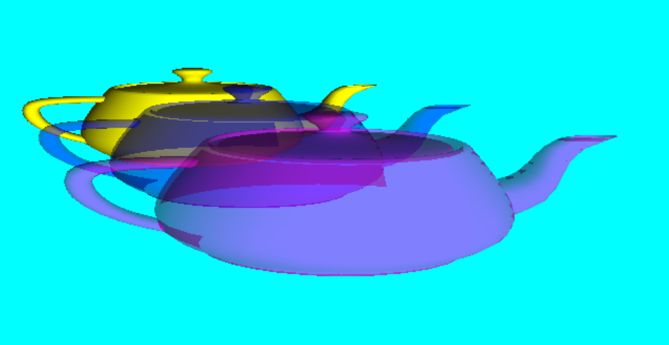
Transparent Volume
glEnable(GL_LIGHTING)
glEnable(GL_LIGHT0)
glEnable(GL_COLOR_MATERIAL)
gluLookAt(0,1.5,5, 0,0,0, 0,1,0)
glLightfv(GL_LIGHT0, GL_POSITION, [0,0,1,0])
glColor4f(1,1,0,1.0)
glutSolidTeapot(0.5)
glTranslatef(0,0,1)
glColor4f(0,0,1,0.5)
glutSolidTeapot(0.5)
glTranslatef(0, 0, 1)
glColor4f(1, 0, 1, 0.5)
glutSolidTeapot(0.5)
glFlush()

Slide 5
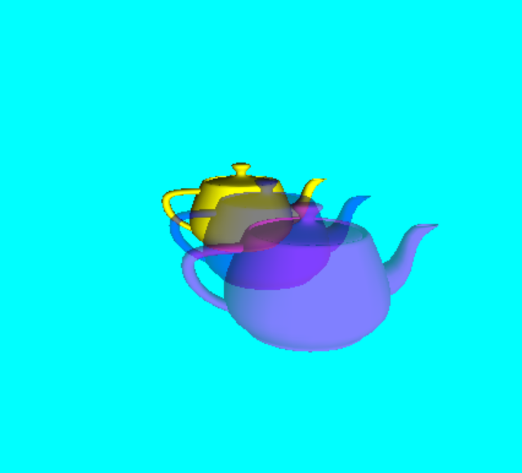
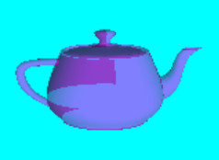
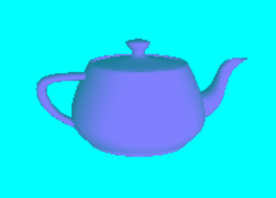
Color Mask
glColor4f(0,0,1,0.5)
glColorMask(GL_FALSE, GL_FALSE, GL_FALSE, GL_FALSE)
glutSolidTeapot(0.5)
glColorMask(GL_TRUE, GL_TRUE, GL_TRUE, GL_TRUE)
glDepthFunc(GL_EQUAL)
glutSolidTeapot(0.5)
glDepthFunc(GL_LESS)
→

Slide 6
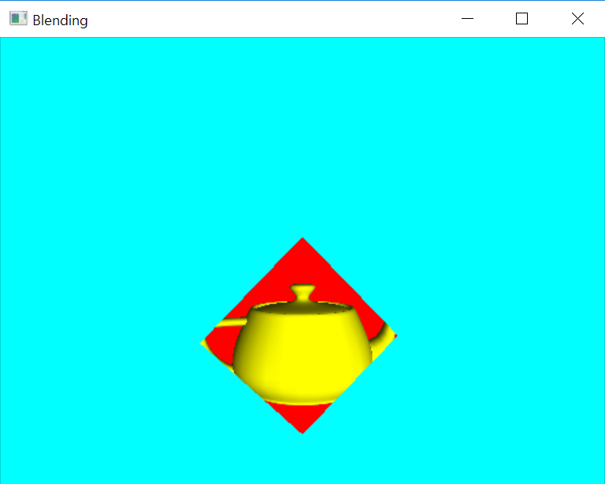
Stencil Test
glClear(GL_STENCIL_BUFFER_BIT)
glStencilFunc(GL_ALWAYS, 0x1, 0x1)
glStencilOp(GL_KEEP, GL_KEEP, GL_REPLACE)
glDepthMask(GL_FALSE)
glColor3f(1, 0, 0)
glBegin(GL_QUADS)
glVertex3f(0.0, 1.0, 0.0)
glVertex3f(-1.0, 0.0, 0.0)
glVertex3f(0.0, -1.0, 0.0)
glVertex3f(1.0, 0.0, 0.0)
glEnd()
glStencilFunc(GL_EQUAL, 0x1, 0x1)
glStencilOp(GL_KEEP, GL_KEEP, GL_KEEP)
glDepthMask(GL_TRUE)
glColor3f(1, 1, 0)
glutSolidTeapot(0.7)
glutInitDisplayMode
GLUT_STENCIL
glEnable
GL_STENCIL_TEST

Slide 7
void glStencilFunc( GLenum func, GLint ref, GLuint mask);
Parameters
func
Specifies the test function. Eight symbolic constants are valid: GL_NEVER, GL_LESS, GL_LEQUAL, GL_GREATER, GL_GEQUAL, GL_EQUAL, GL_NOTEQUAL, and GL_ALWAYS. The initial value is GL_ALWAYS.
ref
Specifies the reference value for the stencil test. ref is clamped to the range [0, 2^{n}−1] where n is the number of bitplanes in the stencil buffer. The initial value is 0.
mask
Specifies a mask that is ANDed with both the reference value and the stored stencil value when the test is done. The initial value is all 1's.

Slide 8
void glStencilOp(GLenum sfail, GLenum dpfail, GLenum dppass);
Parameters
sfail
Specifies the action to take when the stencil test fails. Eight symbolic constants are accepted: GL_KEEP, GL_ZERO, GL_REPLACE, GL_INCR, GL_INCR_WRAP, GL_DECR, GL_DECR_WRAP, and GL_INVERT. The initial value is GL_KEEP.
dpfail
Specifies the stencil action when the stencil test passes, but the depth test fails. dpfail accepts the same symbolic constants as sfail. The initial value is GL_KEEP.
dppass
Specifies the stencil action when both the stencil test and the depth test pass, or when the stencil test passes and either there is no depth buffer or depth testing is not enabled. dppass accepts the same symbolic constants as sfail. The initial value is GL_KEEP.

Slide 9
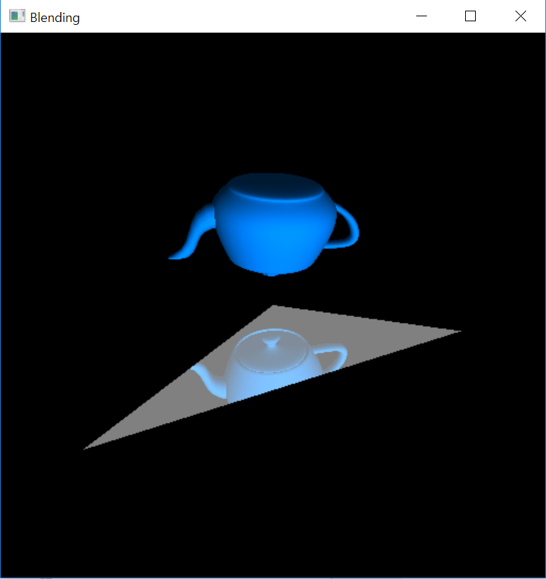
Mirror

Slide 10
glClear(GL_STENCIL_BUFFER_BIT)
# 주전자 그리기
glStencilFunc(GL_ALWAYS, 0x1, 0x1)
glStencilOp(GL_KEEP, GL_KEEP, GL_KEEP)
주전자 그리기
# 거울을 위한 스텐실 영역 설정
glColorMask(0, 0, 0, 0)
glDepthMask(0)
glStencilFunc(GL_ALWAYS, 0x1, 0x1)
glStencilOp(GL_KEEP, GL_KEEP, GL_REPLACE)
거울 그리기 (컬러/깊이 마스크 0로 보이지 않음 - 스텐실만 만들기)
glColorMask(1, 1, 1, 1)
glDepthMask(1)
glStencilFunc(GL_EQUAL, 0x1, 0x1)
# 주전자의 거울상 그리기
거울에 비친 주전자 그리기 (스텐실 영역만 그려짐)
# 거울 그리기
glColor4f(1.0, 1.0, 1.0, 0.5);
거울의 모양 그리기 (블렌딩을 이용하여 주전자가 보이게 함)

Slide 11
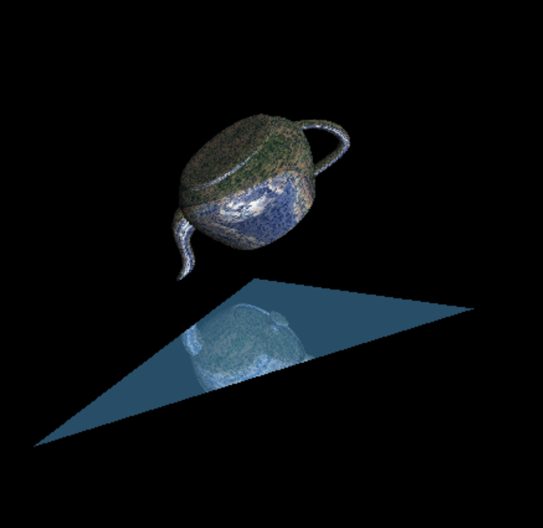
All in one

